Slide 1

Blown to Bits Chapter 6
By: Sarah Hart, Anthony Cordeiro, Jasmin Diaz, Joshua Lim

Slide 2
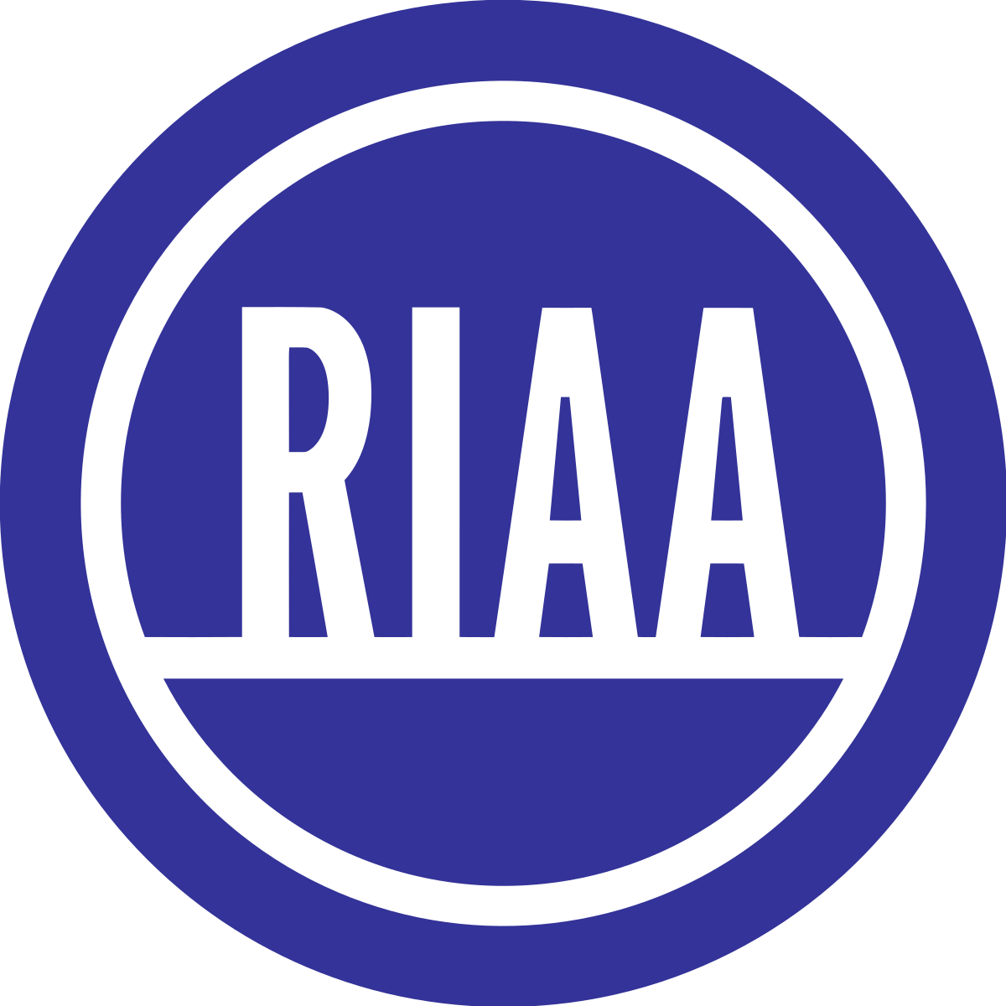
Summary
The RIAA files lawsuits against people who are illegally downloading music
They send a letter to the person with their demands and an opportunity to settle
The RIAA matches names to IP addresses which is unreliable because multiple people share the same address
Each time a song is copied, it counts as a separate infringement
Recording Industry Association of America
Notes:
Anthony

Slide 3


Punishment Throughout the Years
The cost of settling is less than the legal fees for contesting
$750 per song downloaded
1897, punishment was a year in prison and a $1,000 fine
1992, punishment was ten years in prison and stiff fines if the infringement was done for financial gain

Slide 4
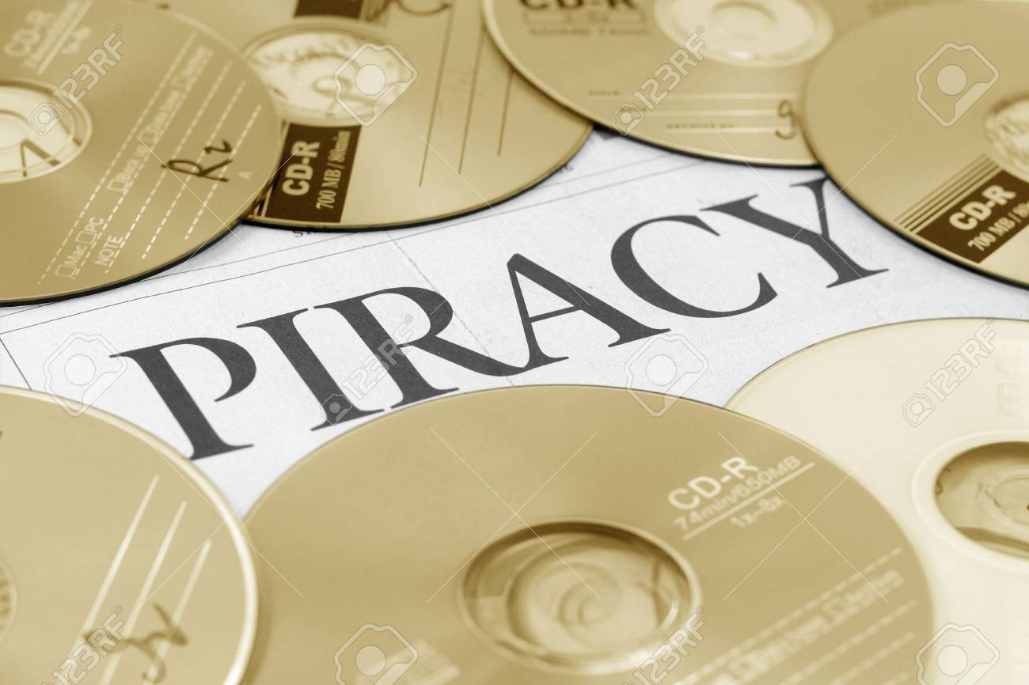
Continued
1994, bootleg copies did not qualify as stolen property so there was no punishment
The 1997 No Electronic Theft (NET) Act meant any unauthorized copying would pay over $1,000

Slide 5

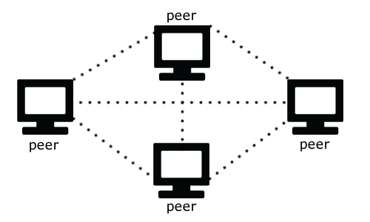
Types of File Sharing
Centralized systems collect files at a central computer for people to download
Peer-to-peer architecture is individual computers passing files among themselves directly (more efficient than centralized systems)
Centralized
Peer-to-peer

Slide 6
Continued
The NET Act marked the first time that the Internet had made a significant expansion of liability for copyright infringement
Napster
Easy to share files
The indignation, or feeling provoked by unfairness, over copyright is intense
Google
Embarked on a project to index the book collections of several large libraries for Google’s search engine.
Notes:
In the summer of 1999, Sean Fanning, a student at Northeastern University, began distributing a new file-sharing program and joined his uncle in forming a company around it: Napster. Napster made it easy to share files, especially music tracks, over the Internet, and to share them on a scale never before seen.

Slide 7
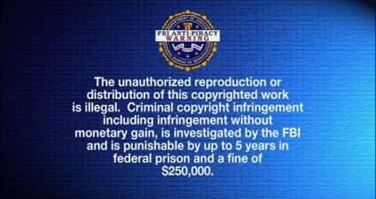
Relevance
Projects that involve research
Explaining ideas
Internet makes it easy to copy other people’s work
Pirated Movies & Music
Internet allows us to see or download movies
Can illegally download music
Chapter emphasizes to not copy
Would be violating copyright laws

Slide 8


Questions
Why do people continue to break the rules even though there are consequences for their actions?
How has copyright infringement laws affected us today?
Will there be better ways to protect this type of content in the future?

